Slide 1
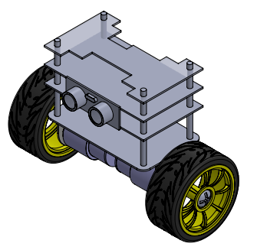
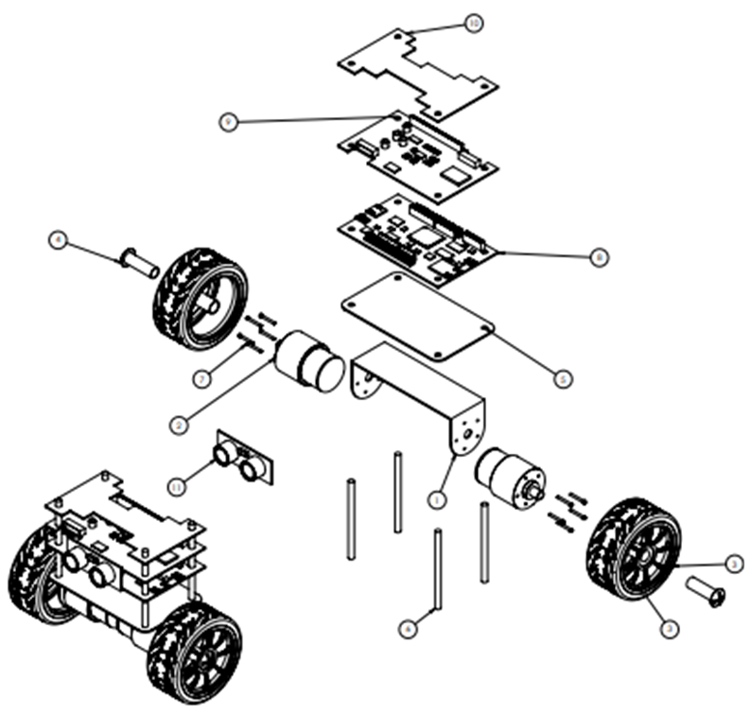
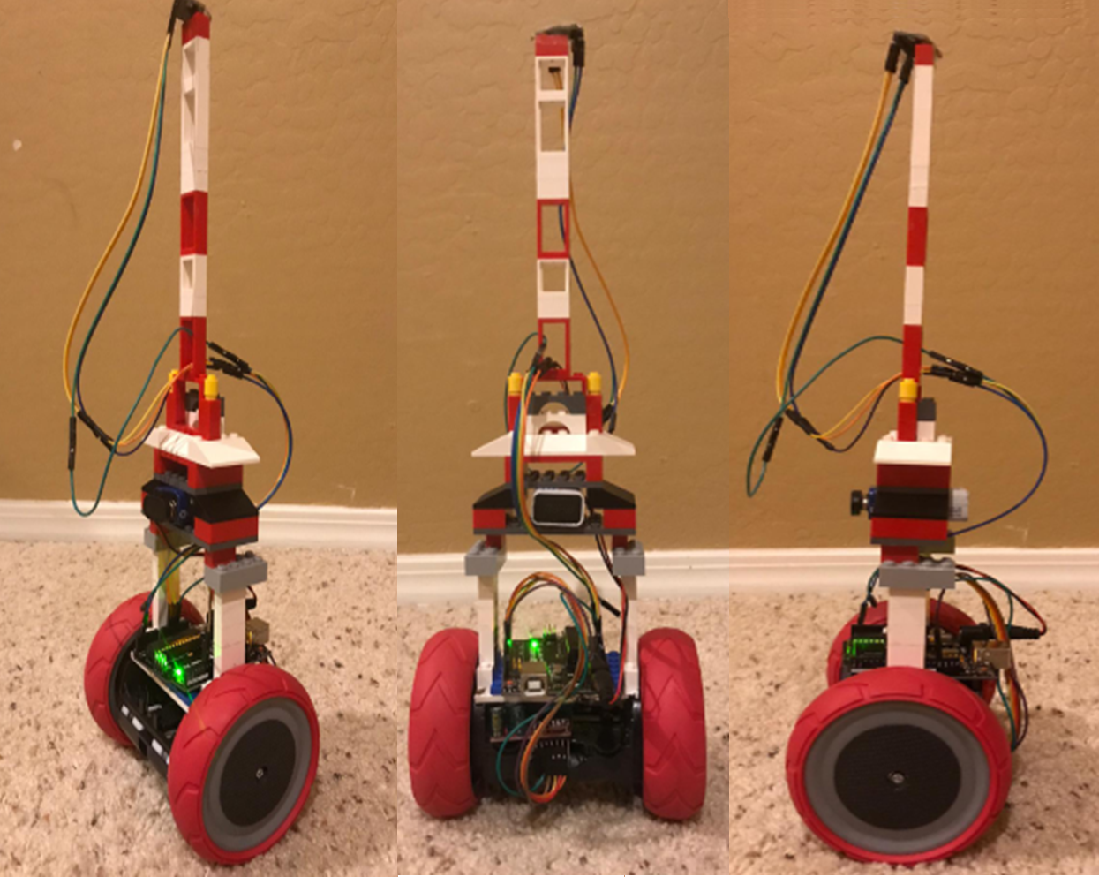
BALANCING ROBOT
Project Sponsor: PROGRAM FEES
Instructor and Faculty Advisor: Dr David Trevas
FAHAD ALSTATH and NAIF ALFIHAN
Abstract
Final Design
Results
.
Purpose of this project was to develop any kind of robot which can perform for the RoboGames, and there were different competitions that can take part with the robot. From these competitions we have decided to develop a robot which can take part in the balancing competition. Balancing competition will check the robot balancing on different terrains and the robot need to travel for 3 minutes or less than that and the robot need to move in the arena of 180 meters for showing the balancing. With all these descriptions we have started the design project and selected the design first after generating multiple ideas. A robot with two wheelers have developed and it balance using the gyroscope sensors
Torque require to move the robot T = 4 *10^-4 Nm
RPM Speed of Motor is Speed = 300 rpm
Operating Voltage V = 11.1 V – 13.8 V
P = 120 Watts
Conclusion
Controller can control the device
Robot can balance on all type of surfaces
Robot can move with the speed 2.5 m/s.
Speed variation is available
Strong elevation from top to bottom
Device can use for commercial purpose
Arduino is using as a microcontroller
Gyroscope is using for balancing
Background
Figure 1: FINAL DESIGN CAD PACKAGE
Final Product
Balancing the robot over the rough terrains in difficult specifically when the robot is two wheeler.
Controlling the robot using the remote in the competition arena cause problem
Long Battery Backup and speed both are opposite terms for any robot.
References
Requirements
[1] M. Board, “Convert the angular velocity to m/s calculator”, available [online].
[2] K. Joh, “Power and Torque with the RPM”, available [online].
[3] S. DC, “Relating the Voltage with the RPM”, available [online].
[4] C. Gonzalez, “Low Cost Two Wheels Self-Balancing robot for control education”, July 2017, Vol. 50, Issue 1. By IFAC Papers Online.
Table 1: Engineering Requirements
Engineering Requirements | Targeted Values | Tolerance
Dimension | 115 cm^2 | 10 cm^2
Battery Time | 12 minutes | 4 minutes
Moving Capacity in the Arena | 45 meters | 10 meters
Height | 18 cm | 4 cm
Wheel Radius | 5 cm | 2 cm
Degree of Freedom | 6 Degrees | 4 Degrees
Width | 7 cm | 2 cm
Weight | 5 lb. | 2 lb.
Acknowledgement
We would like to acknowledge Program Fees for letting us work on this project and acknowledge the support of instructor for helping us in designing the project. And we would like to say thanks to NAU for providing us the free environment to work on this project and do some learning.
Figure 2: FINAL PRODUCT

